Slide 1

Mini Project-IOT based- Under Sensor Lab
(Semester VI)
Vivekanand Education Society’s Institute of Technology
Information Technology
Name of Supervisor :Dr. Monali Chaudhari
Title of Project:Water level monitoring
Group No. : _4_ Student Name Roll No.
1.Pranav Raikar -47(D15A)
2.Gaurang Raorane -49 (D15A)
3.Tejas Rokade -50(D15A)
4.Sneha Utekar -66(D15A)

Slide 2
Contents
Problem Statement
Proposed Solution
Literature Survey
Competitions/Research Gaps
Complete Block Diagram of Proposed System
Components requirement
Steps involved in interfacing of sensors with NodeMCU ESP8266
Hardware Implementation
Time Chart
References

Slide 3
Problem Statement
Create an IoT project to address the issue of water wastage due to overflow from overhead tanks. Develop a reliable water level detection system that alerts users when the tank approaches full capacity, preventing excess overflow and promoting efficient water usage.

Slide 4
Proposed Solution
The proposed solution involves employing ultrasonic sensors in an IoT-based system to monitor overhead tank water levels. When the tank approaches full capacity, the ultrasonic sensor detects the rising water level and sends wireless notification to a remote device through wifi module,thus making it possible to see the water level on the blynk app user interface. This ensures timely awareness, enabling users to manage water resources efficiently and prevent potential overflow incidents. The ultrasonic sensors provide accurate and reliable measurements, enhancing the overall effectiveness of the solution. Through this integration, the project aims to optimize water usage, mitigate wastage, and foster responsible resource management practices in a seamlessly connected environment.

Slide 5
Literature Survey
Sr. No. | Title of Technical paper | Name of Author | Year of publication | Name of Journal | Methodology | Results/ conclusion | Drawbacks/ limitations
1. | Real Time Internet of Things (IoT) Based Water Quality Management System[2] | Saif Allah H. Al Metwally a , Mohamed K. Hassan b , Mohamed H. Mourad | 2020 | Elsevier | Use of Multiple Sensors for best water quality management (Arduino Uno) | Implemented successfully | The entire System becomes costlier.
2. | Internet of Things (Iot) Enabled Water Monitoring System[3] | N. SIVAIAH 1 , K. PURNA SAI SOWMYA 2 , K. SUSMITHA 3, N. ANILA SAI4 , N. SUMA5 | 2018 | IRE Journals | IoT Water Monitoring with Ultrasonics (Arduino Uno) | The data is been successfully displayed on dashboard remotely. | Ultrasonic sensor precision is low.

Slide 6
Sr. No. | Title of Technical paper | Name of Author | Year of publication | Name of Journal | Methodology | Results/ conclusion | Drawbacks/ limitations
3. | IoT based Smart Water Monitoring System [1] | Rohit Kumar1 , Shubham 1 , Palak Shandil 2 , Avinash Kumar 3 , Bhgah Y. Adam4 , Hamza Abdullah M. Adam5 , Sushil Dohare 5 , Saptadeepa Kalita 1* | 2023 | eurchembul | Sensor Integration Data Aggregation Field testing Optimization System Design (Raspberry Pi) | Offers scalable and efficient solution for real time water management | Cost Dependency on Internet Connectivity

Slide 7
Comparison/competition in the market & Research Gap
IOT Based Smart Water Level Controllers (Operated by Switch/MCB)
Water Level Depth Detection Sensor Module from ElectronicsComp.com
Are some of the available products in market which cost comparatively more
Technology Comparison:
Sensor Technology: Compare the ultrasonic sensor technology proposed in your solution with other sensor technologies available in the market. Consider factors like accuracy, durability, and maintenance requirements.
Wireless Communication: Assess the efficiency of the wireless communication method (in this case, Blynk app) in comparison to other communication protocols used in similar systems.

Slide 8
Comparison/competition in the market & Research Gap
Cost of Components: Evaluate the cost of the ultrasonic sensors, microcontrollers, and other components used in your IoT project compared to alternative technologies.
Installation and Maintenance Costs: Consider the overall cost of implementing and maintaining the proposed solution compared to existing alternatives.
Sensor Accuracy: Investigate the accuracy of ultrasonic sensors in detecting water levels compared to other sensing technologies.
Notification Reliability: Assess the reliability and speed of the notification system through the Blynk app compared to alternative notification methods

Slide 9
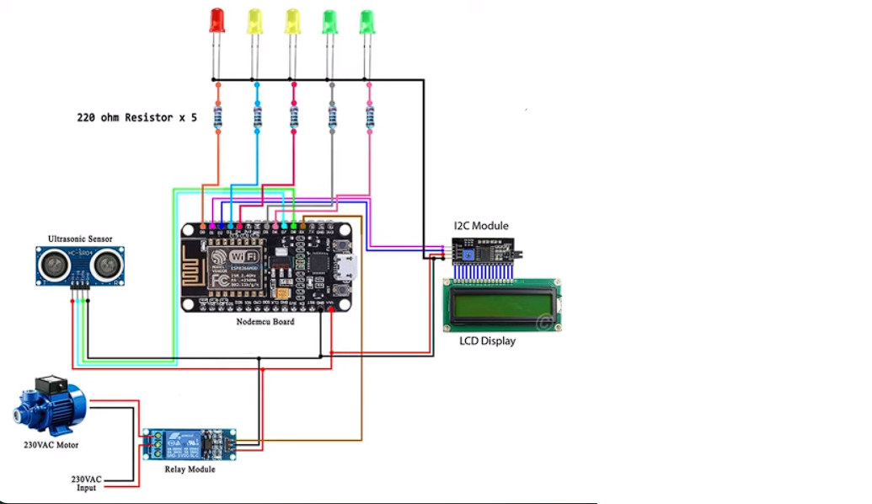
Complete Design/Circuit diagram Flow graphs of Proposed System
Block diagram

Slide 10
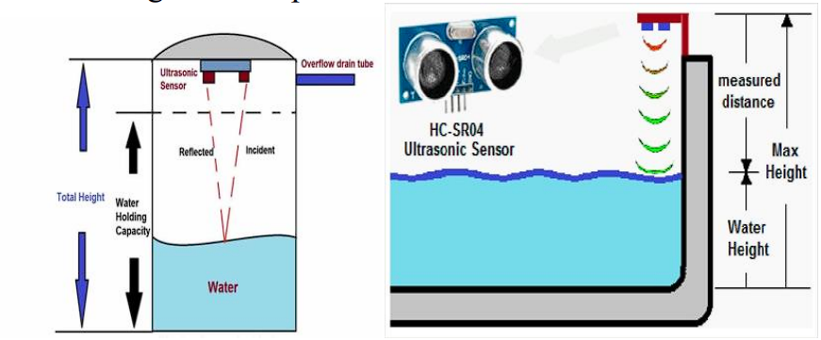
Complete Design/Circuit diagram Flow graphs of Proposed System

Slide 11
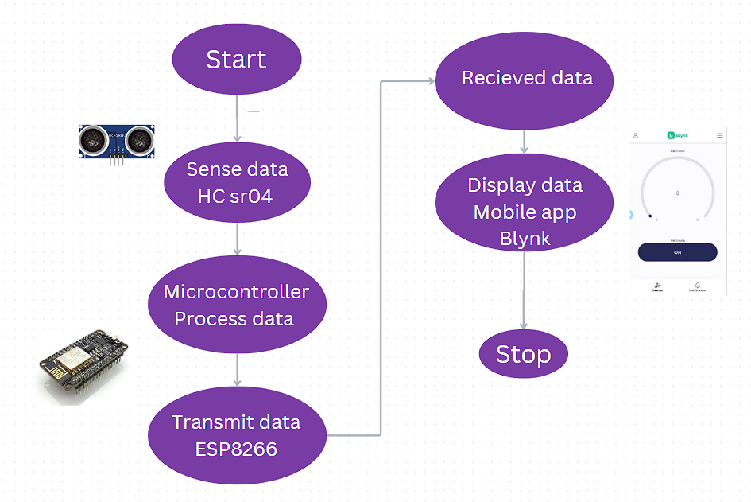
Complete Design/Circuit diagram Flow graphs of Proposed System

Slide 12
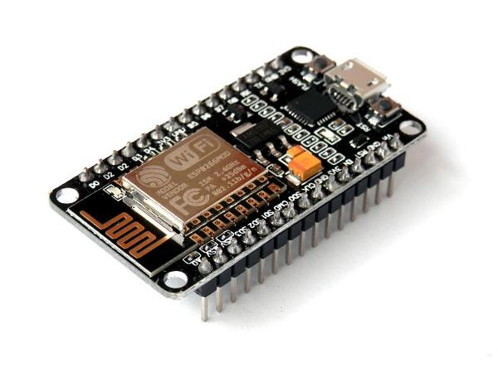
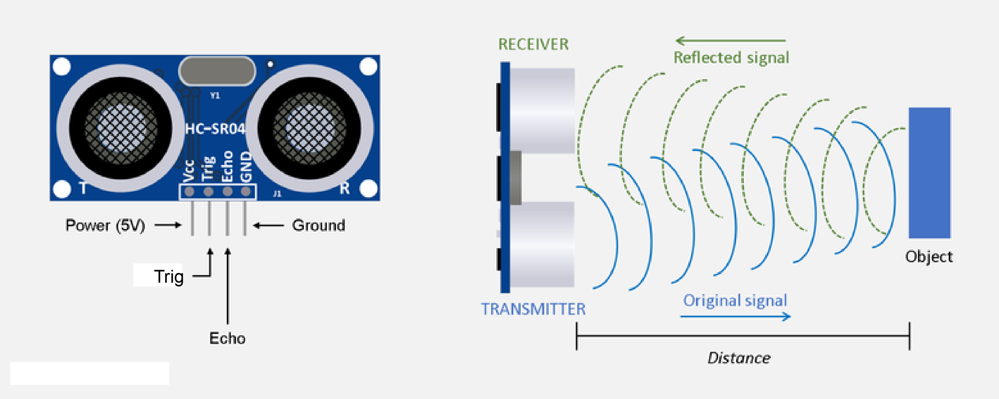
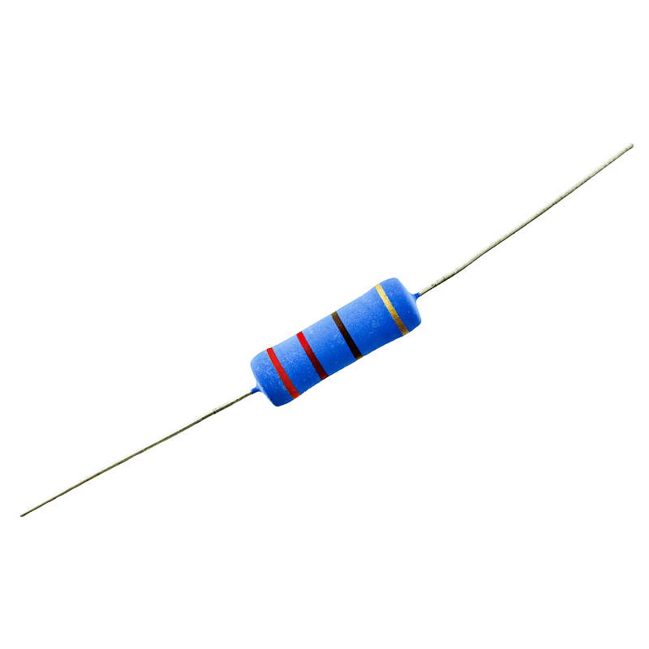
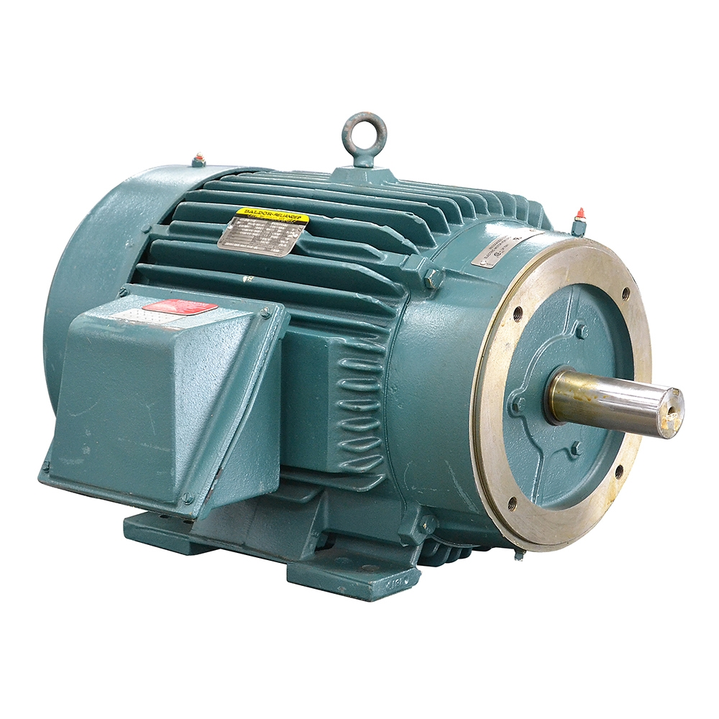
Component List with specification
Main Components:
NodeMCU ESP8266:
Microcontroller for processing data and controlling other components.
Ultrasonic Sensor:
Measures the distance to the water surface using
sound waves.
220 Ohm Resistors:
Limit current flow to the ultrasonic sensor and LED.
Wi-Fi Module: Enables the ESP8266 to connect to the internet and send data to an IoT platform.It is present in NodeMCU ESP8266
230VAC Motor: (Optional)
Controls a pump or valve based on the water level.

Slide 13
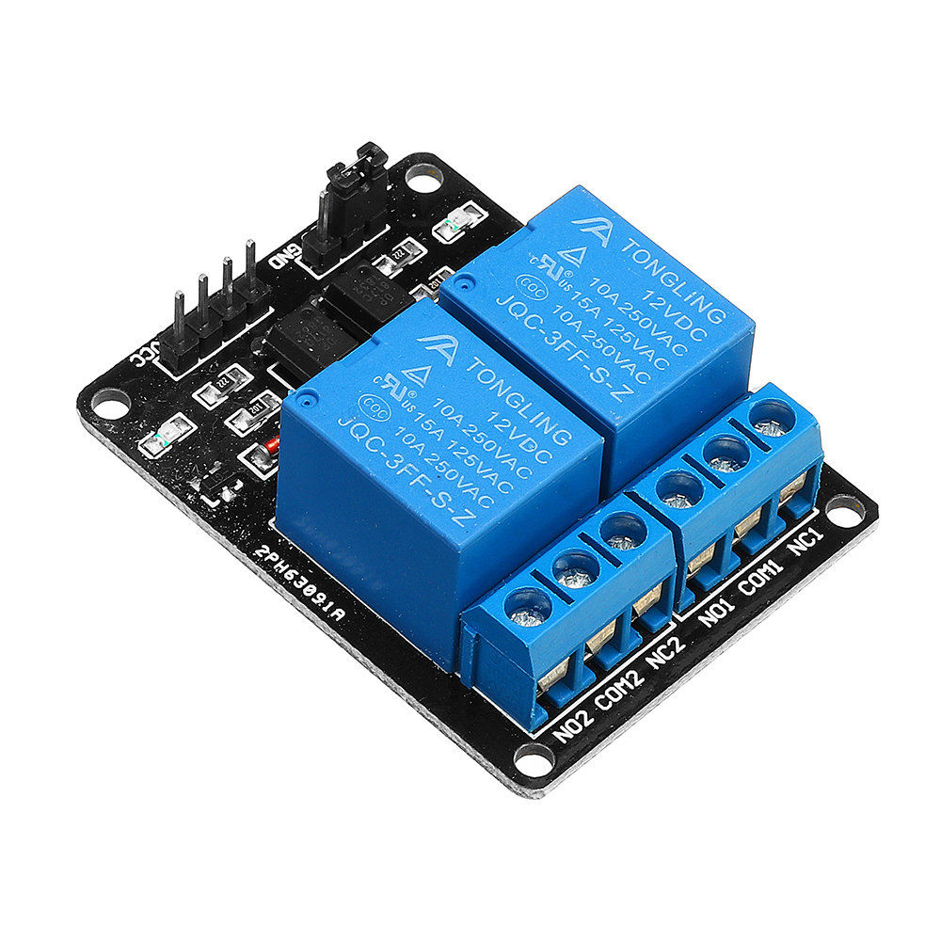
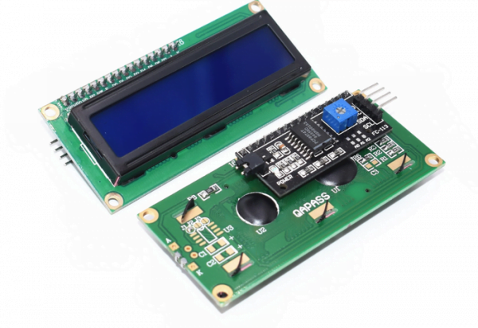
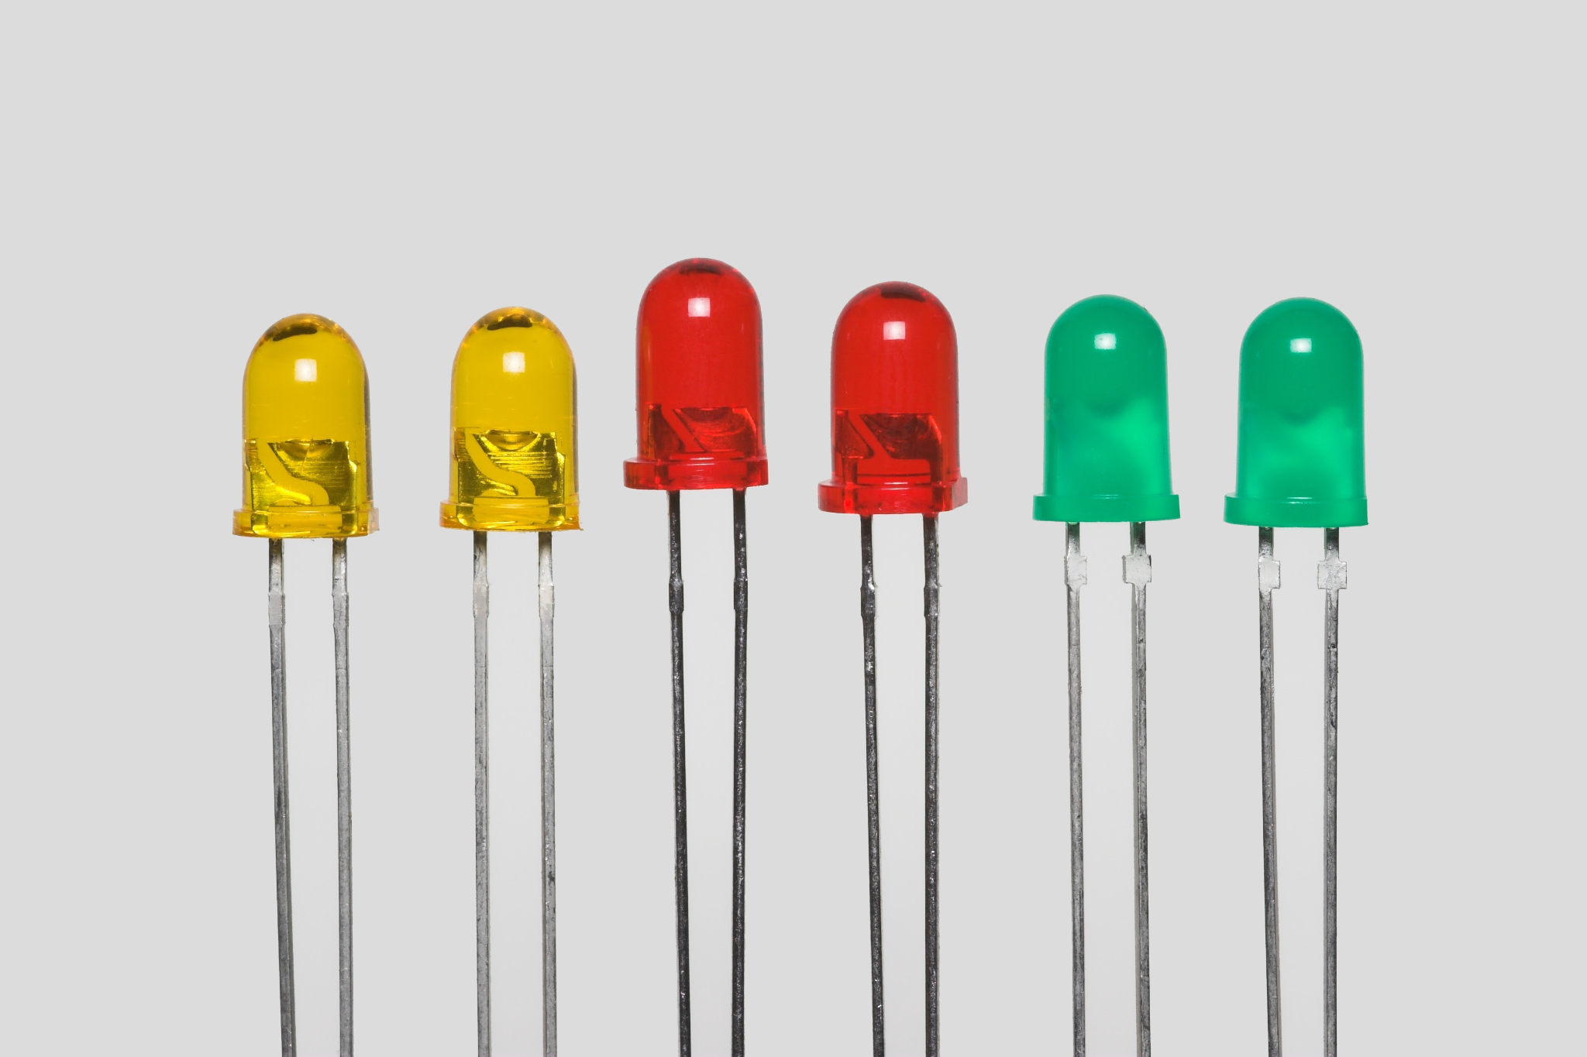
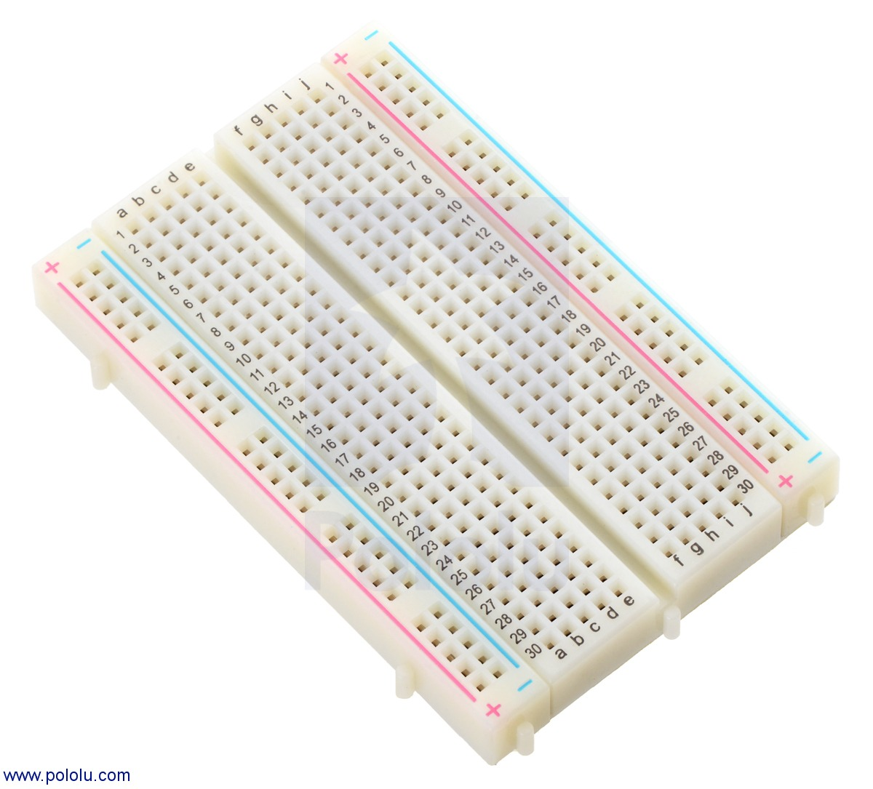
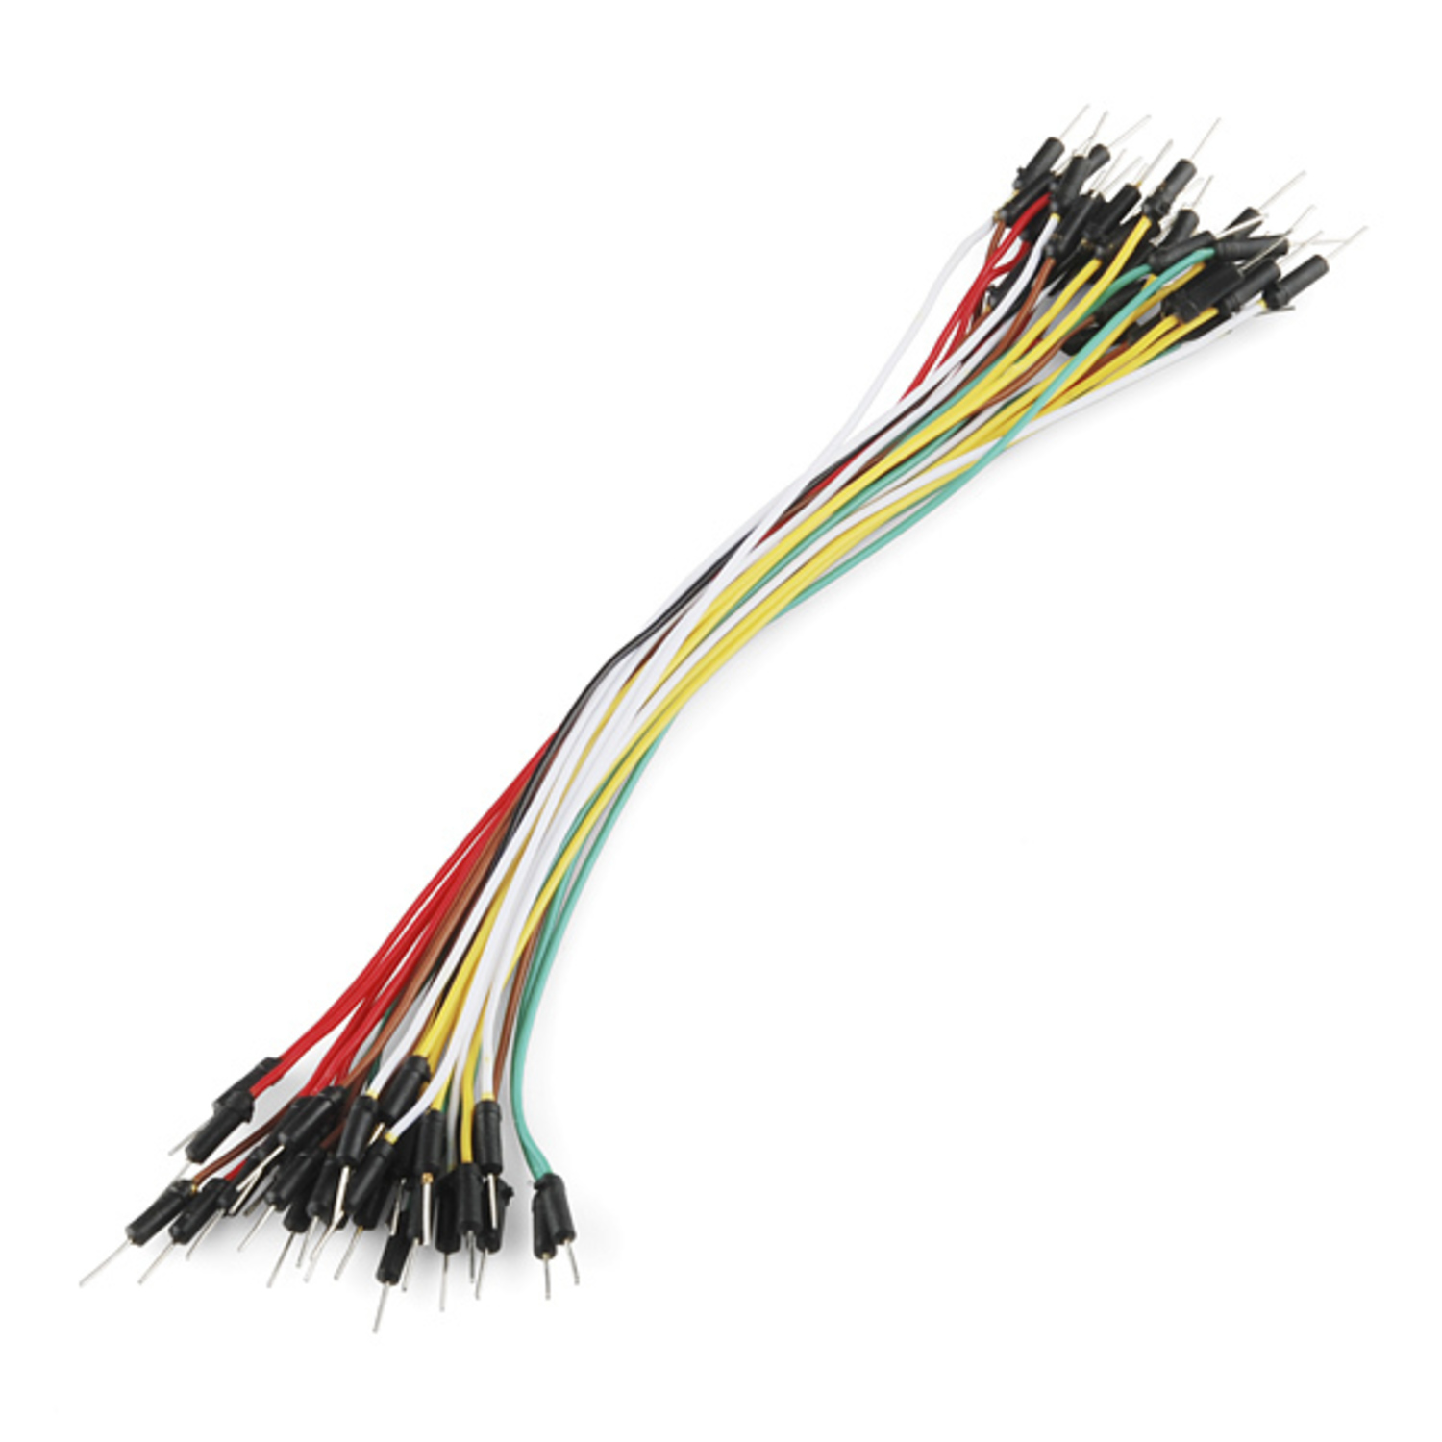
Relay Module: (Optional)
Controls the 230VAC power supply to the motor.
Additional Components:
LCD Display: (Optional)
Displays the current water level reading.
I2C Module: (Optional)
Enables additional sensor inputs or
communication with other devices.
LED: (Optional)
Indicates various system states.
Breadboard:
Connects the components together for testing and prototyping.
Jumper Wires:
Connect the components on the breadboard.
Tools to be used for implementation-Blynk Software used as the user interface

Slide 14
Steps involved in interfacing of sensors with NodeMCU ESP8266:
1)Identify the components: NodeMCU ESP8266 board, ultrasonic sensor, LCD screen
2)Set up the hardware:
a. Place NodeMCU board and Jumper wires on the breadboard.
b. Connect LCD screen, ultrasonic sensor to NodeMCU board following the circuit diagram.
3)Set up Blynk web app:
a. Create a new account on the Blynk website.
b. Log in and create a new project, adding data streams for water level and water pump.
c. Create a web dashboard with appropriate widgets (button, gauge) linked to the data streams.
d. Create a new device and link it to the project.
4)Set up Blynk mobile app:
a. Download and install the Blynk app on your smartphone.
b. Add button and gauge widgets to the dashboard, linking them to the data streams.
c. Customize widgets as needed.
5)Upload the program:
a. Connect NodeMCU board to the computer.
b. Upload the program for the water level monitoring system.

Slide 15
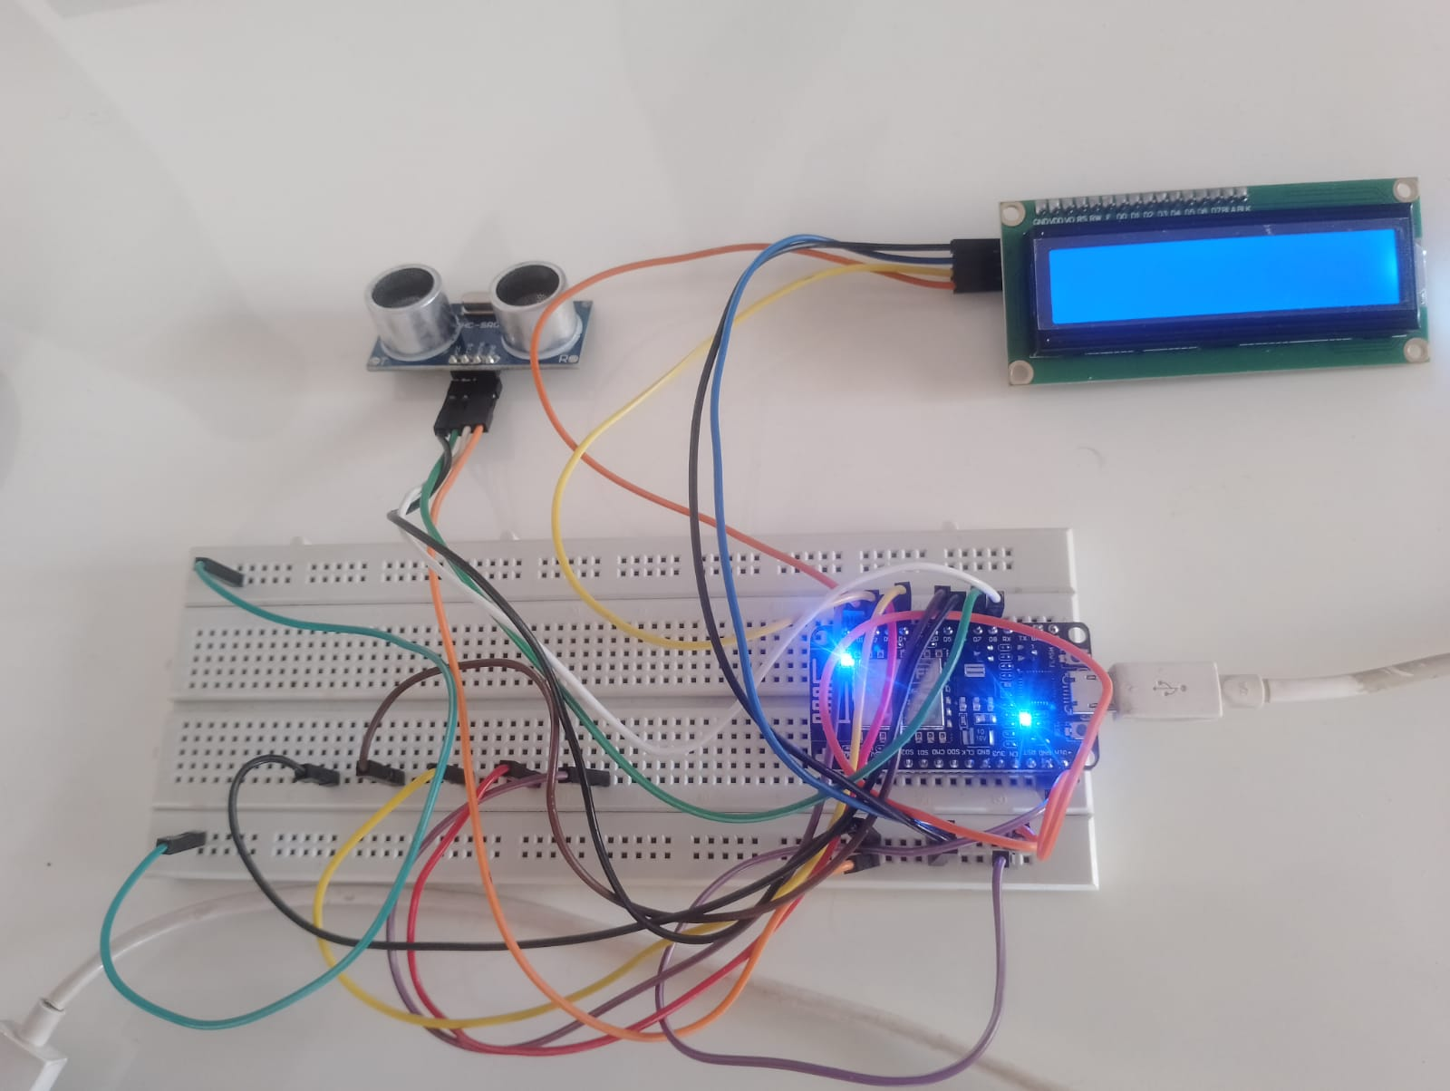
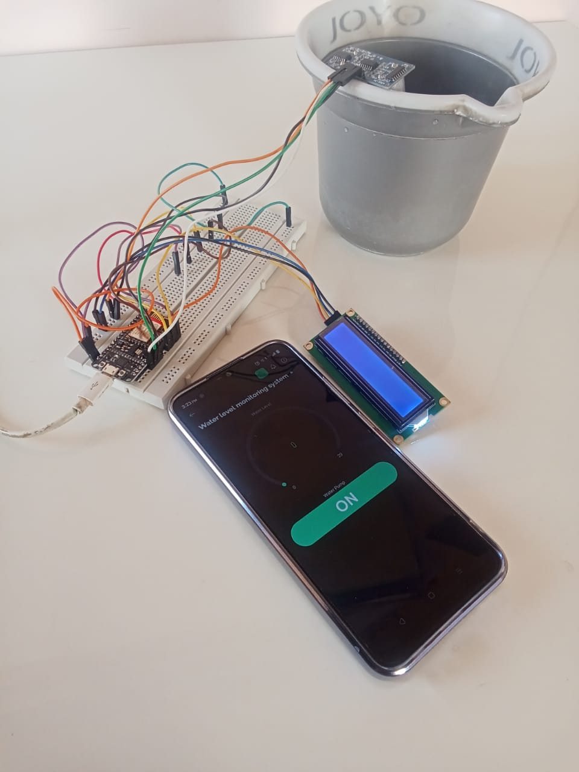
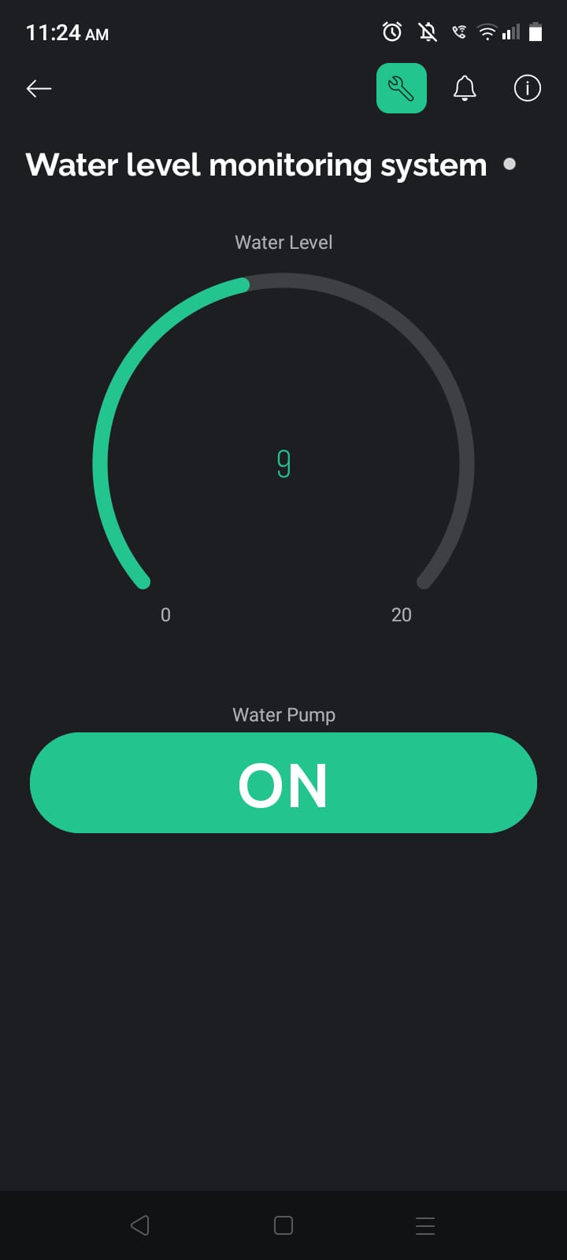
Hardware Implementation
Hardware Setup
Results
Video Link: Water Level Monitoring System

Slide 16
Time Chart
January 2024
WEEK 1
WEEK 2
WEEK 3
WEEK 4
WEEK 5
Brainstorming
Ideas
Feasibility Study
Finalization
of
Topic
Finalizing the
Components
Topic
Presentation

Slide 17
References
Malche, Timothy & Maheshwary, Priti. (2017). Internet of Things (IoT) Based Water Level Monitoring System for Smart Village. 10.1007/978-981-10-2750-5_32.
Saif Allah H. AlMetwally, Mohamed K. Hassan, Mohamed H. Mourad, Real Time Internet of Things (IoT) Based Water Quality Management System, Procedia CIRP, Volume 91, 2020, Pages 478-485, ISSN 2212-8271, https://doi.org/10.1016/j.procir.2020.03.107.
Author(s): K PURNA SAI SOWMYA ; K Susmitha ; N Anila Sai ; N Suma ; N Sivaiah Paper ID: 1700167 Page: 40-43 Published Date: 24-02-2018 Published In: Iconic Research And Engineering Journals Publisher: IRE Journals e-ISSN: 2456-8880 Volume/Issue: Volume 1 Issue 8 February-2018

